Slide 1
Data Structure - Graphs

Slide 2
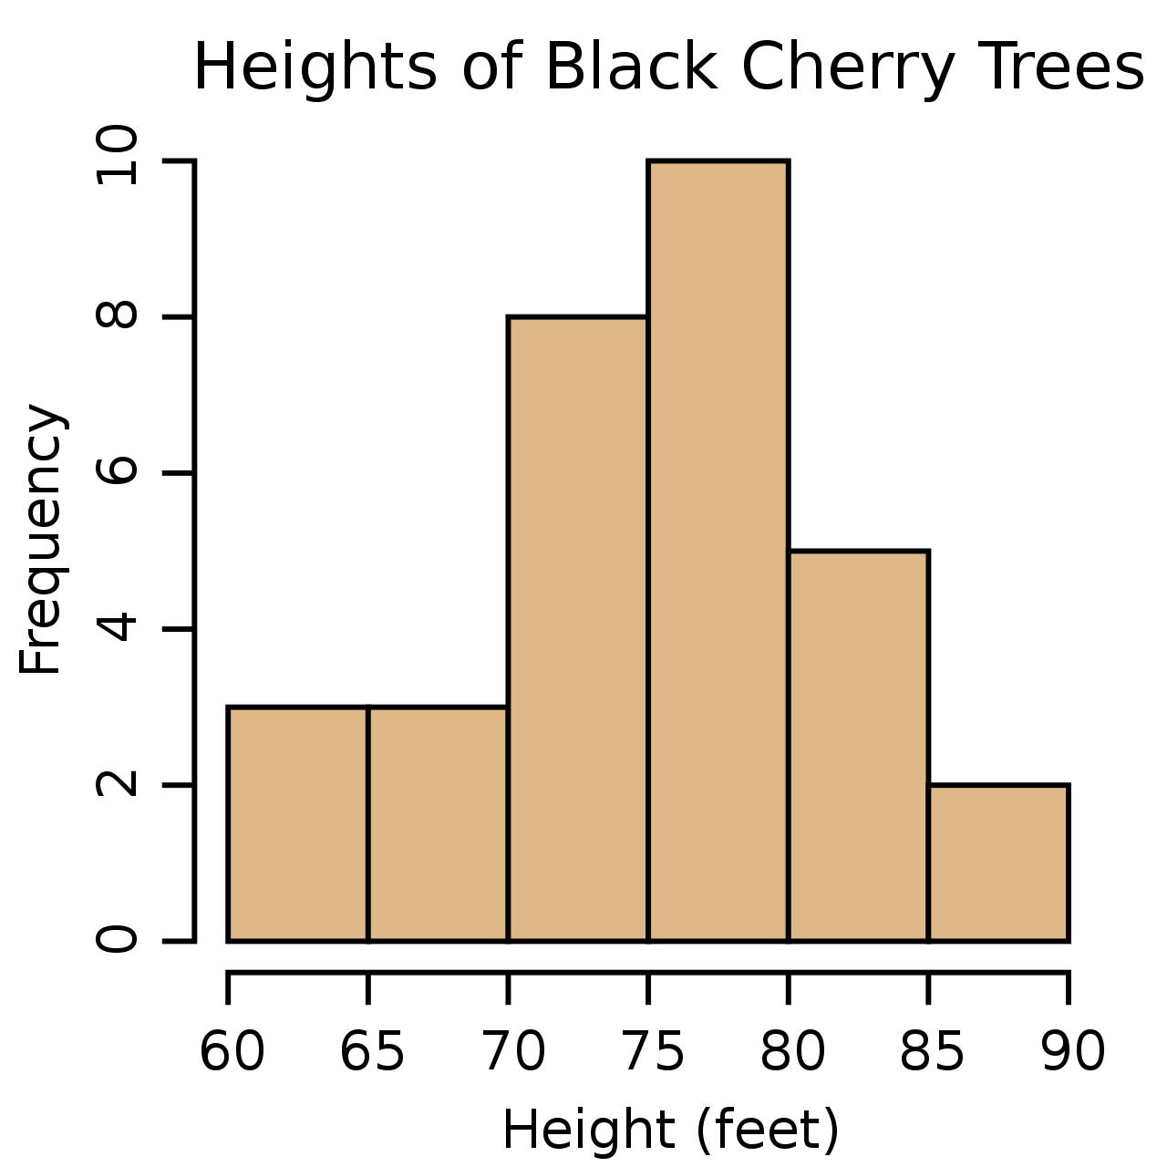
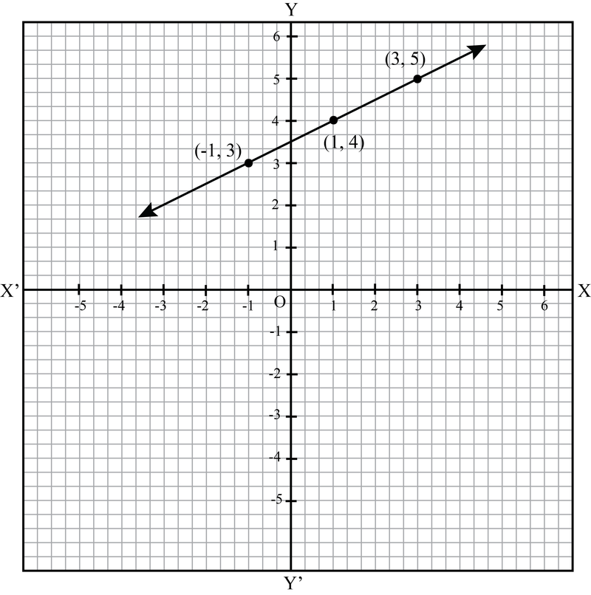
Graph (Data Structure) should not be confused with charts/function plots.

Slide 3
Graph is a non-linear data structure consisting of nodes (aka vertices) and edges
Used to represent relationship between objects/entities
(Note: ‘objects’ should not be confused with class instances/objects)
Objects/Entities can be represented by nodes
Relationship between each pair of object can be represented by edges
Edge (relationship)
Node 1
Node 2

Slide 4
Examples - Simple
759 miles
is a perquisite of
ATL
JFK
CSC1301
CSC1302
Transportation modeling
Dependency modeling
Facebook friends
Bob
Alice
Representing social network

Slide 5
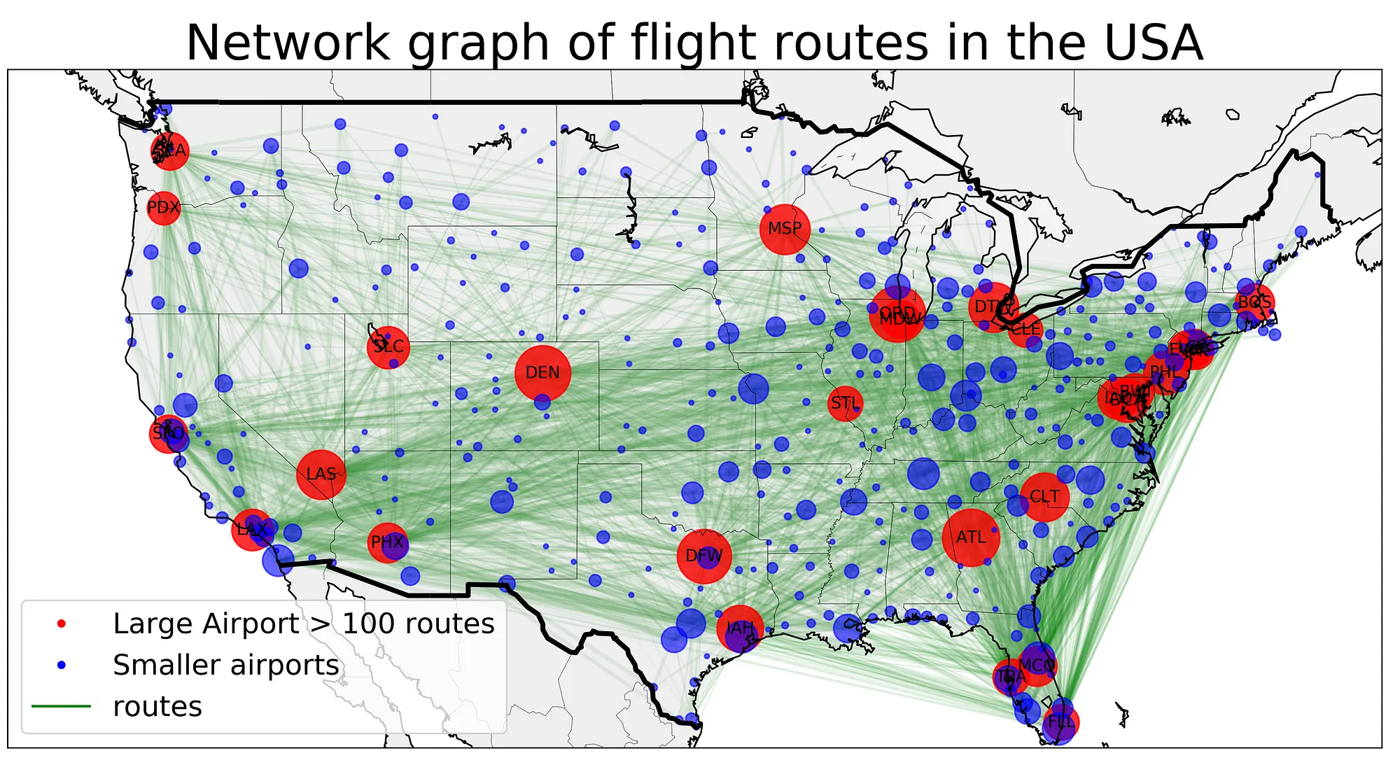
Examples - Complex
https://towardsdatascience.com/catching-that-flight-visualizing-social-network-with-networkx-and-basemap-ce4a0d2eaea6

Slide 6
Going back to simple examples….
759 miles
is a perquisite of
ATL
JFK
CSC1301
CSC1302
Transportation modeling
Dependency modeling
Do you see any differences between these two graphs?
Undirected vs Directed Edges!

Slide 7
Directed vs Undirected Graphs
1
2
1
2
3
4
3
4
Undirected Graph
(edges have no specific directions)
Directed Graph
(edges have specific directions)

Slide 8
Weighted vs Unweighted Graphs
13
1
2
1
2
7
5
3
4
3
4
9
Unweighted Graph
(edges don’t have associated numerical values/weights)
Weighted Graph
(edges have associated numerical values/weights)

Slide 9
Acyclic vs Cyclic Graphs
1
2
1
2
3
4
3
4
Acyclic Graph
(don’t have any cycles)
Cyclic Graph
(have cycles)
Cycle – A path through a graph that starts and ends at the same node.
(without visiting any node more than once along the way)
Undirected graphs can be cyclic/acyclic as well.

Slide 10
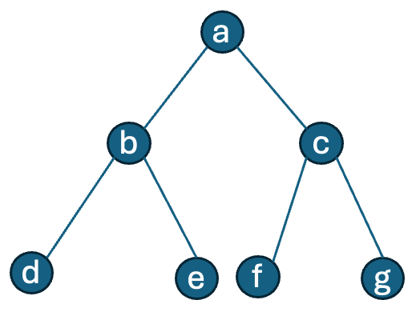
Trees vs Graphs?
Cycles: Trees don’t have any cycles, while graphs may have cycles
Connectivity: All the nodes of a tree are connected, which may not be the case for graphs.
Edge direction: Edges of a graph can be directed/undirected
Application: Suitable for different application scenarios.
E.g. Tree → File System, Graph → Social Network
a
b
c
d
e
f
g
A binary tree
A sample graph

Slide 11
Graph Representation
Adjacency Matrix
Adjacency List
Others...

Slide 12
Adjacency Matrix Representation
Represents the graph using a 2-D array of size nxn
Here, n is the number of nodes
Rows and columns represents the nodes of the graph
If there is an edge between node u and v, a special value is assigned to arr(u,v)
Space complexity: O(n²)
0
1
2
3
0
1
0
0 | 1 | 1 | 0
1 | 0 | 1 | 0
1 | 1 | 0 | 1
0 | 0 | 1 | 0
1
2
3
2
3
arr

Slide 13
Adjacency Matrix Representation (Directed graph)
0
1
2
3
0
1
0
0 | 1 | 1 | 0
0 | 0 | 0 | 0
0 | 1 | 0 | 1
0 | 0 | 0 | 0
1
2
3
2
3
arr

Slide 14
class Graph:
def __init__(self, n):
self.nodes = n
# create the 2-D matrix
self.adj = matrix = [[0] * n for _ in range(n)]
def add_edge(self, u, v):
self.adj[u][v] = 1
def print_adj_matrix(self):
for row in self.adj:
print(row)
graph = Graph(4)
graph.add_edge(0, 1)
graph.add_edge(0, 2)
graph.add_edge(2,1)
graph.add_edge(2,3)
graph.print_adj_matrix()
Adjacency Matrix Coding Example
0
1
2
3

Slide 15
Adjacency Matrix Representation – Space Complexity
What if there are 1000 nodes, with only a few hundred edges?
- Will still occupy an array of size (1000x1000) to store those edges

Slide 16
A more memory efficient approach – Adjacency List Representation
In this representation, each node is associated with a list that
contains the neighboring nodes.
0
1
Nodes
Adjacent Nodes
0
1 | 2
1
0 | 2
2
0 | 1 | 3
2
3
3
2
Space Complexity – O(V+E) where V is the number of nodes/vertices
and E is the number of edges.

Slide 17
class Graph:
def __init__(self):
# create a dictionary
self.adj_list = {}
def add_edge(self, u, v):
if u in self.adj_list:
self.adj_list[u].append(v)
else:
self.adj_list[u] = [v]
def print_adj_list(self):
for key in self.adj_list:
print('Node: ', key, ' Neighbors: ', self.adj_list[key])
graph = Graph()
graph.add_edge(0, 1)
graph.add_edge(0, 2)
graph.add_edge(2,1)
graph.add_edge(2,3)
graph.print_adj_list()
Adjacency List Coding Example

Slide 18
Graph Traversal
Breadth First Search (BFS)
Depth First Search (DFS)

Slide 19
Breadth First Search
Starting from the source, it explores the graph level-by-level
Uses a queue to ensure such exploration
Depth First Search
Starting from the source, it explores the graph branch-by-branch
Uses a stack to ensure such exploration

Slide 20
0
1
2
3
4
5
6
BFS (source=0) 0 > 1 > 2 > 3 > 4 > 5 > 6
DFS (source=0) 0 > 1 > 3 > 5 > 6 > 2 > 4

Slide 21
- Exam 2 syllabus has been updated (Graph topics added)
- Please download the updated version from iCollege.

Slide 22
Attendance

